Slide 1
SITKA Elastic Ordering Process

Slide 2
Order Creation
Once you’ve logged in, you’ll find this home page. To place an order, select Shop Now.

Slide 3
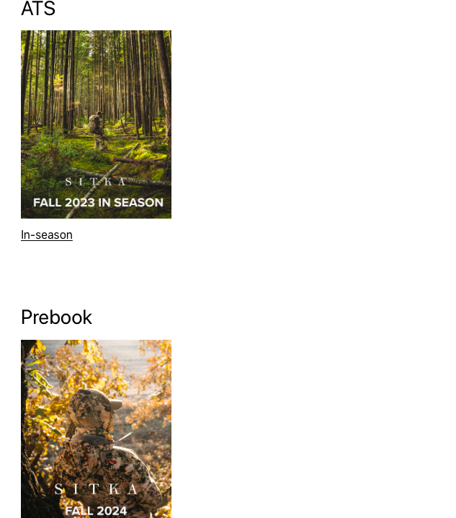
Catalog Selection
Use the ATS catalog to fill existing inventory
Use the Prebook catalog to place upcoming seasonal orders
From here, you have the options of selecting from ATS or Prebook Catalogs.

Slide 4
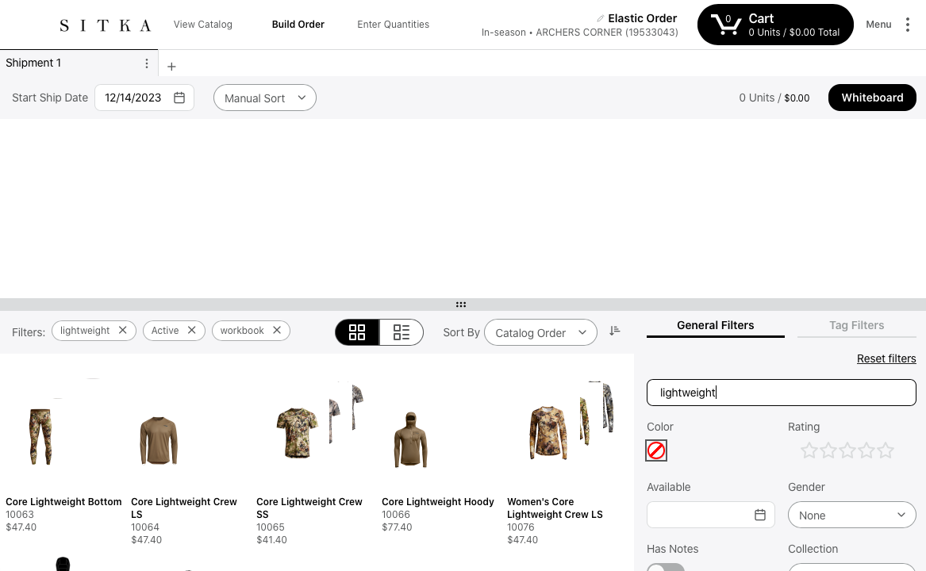
Product Selection
After selecting a catalog, select Build Order and use the search bar to begin adding items to the cart

Slide 5
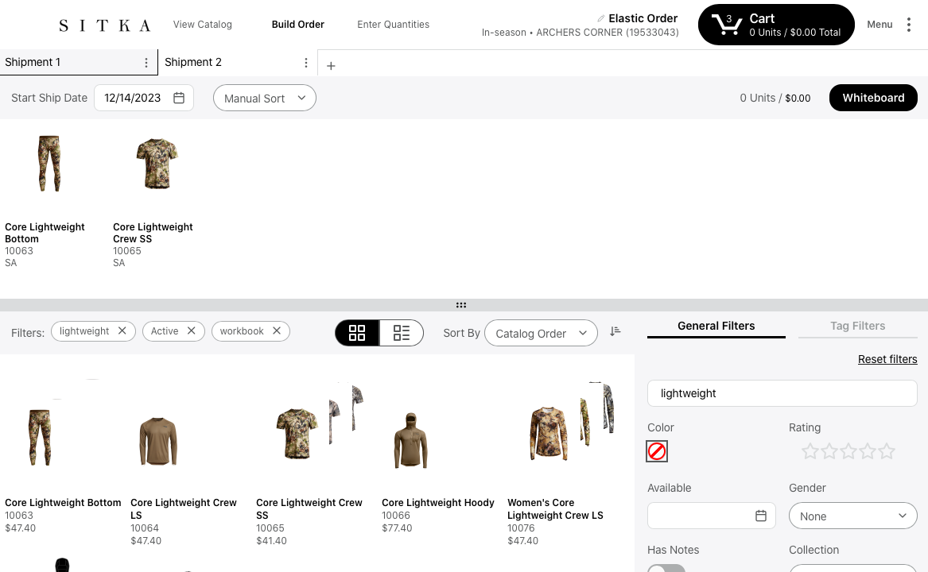
Shipment Dates and Multiple Shipments
To add multiple ship dates, select the “+” symbol
next to “Shipment 1”.
You can add as many shipments as needed.
To edit ship dates, select the calendar icon next
to “start ship date” on the selected shipment tab and fill in as needed

Slide 6
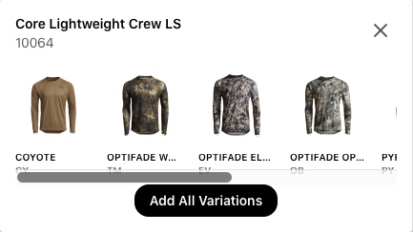
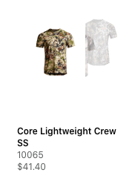
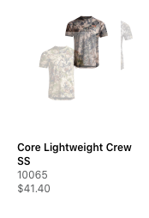
Colorway Selection
OR
To select certain colorways, select the name of
the product under the image
To select certain colorways, hover your mouse
over the desired colorway and select it

Slide 7
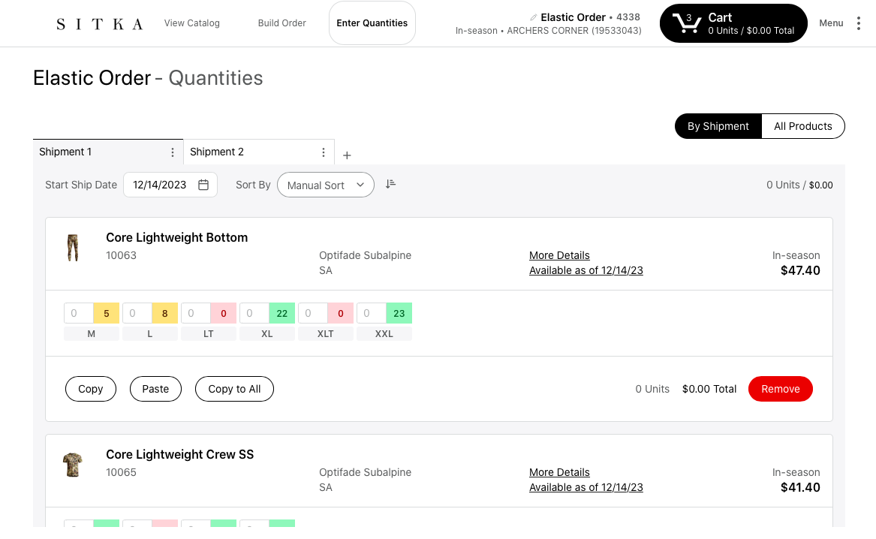
Size and Quantity
When you are ready to enter sizes and quantities, select Enter Quantities and enter your desired sizes and quantities

Slide 8
Once you’ve completed your order, click the Cart icon at the top of the page

Slide 9
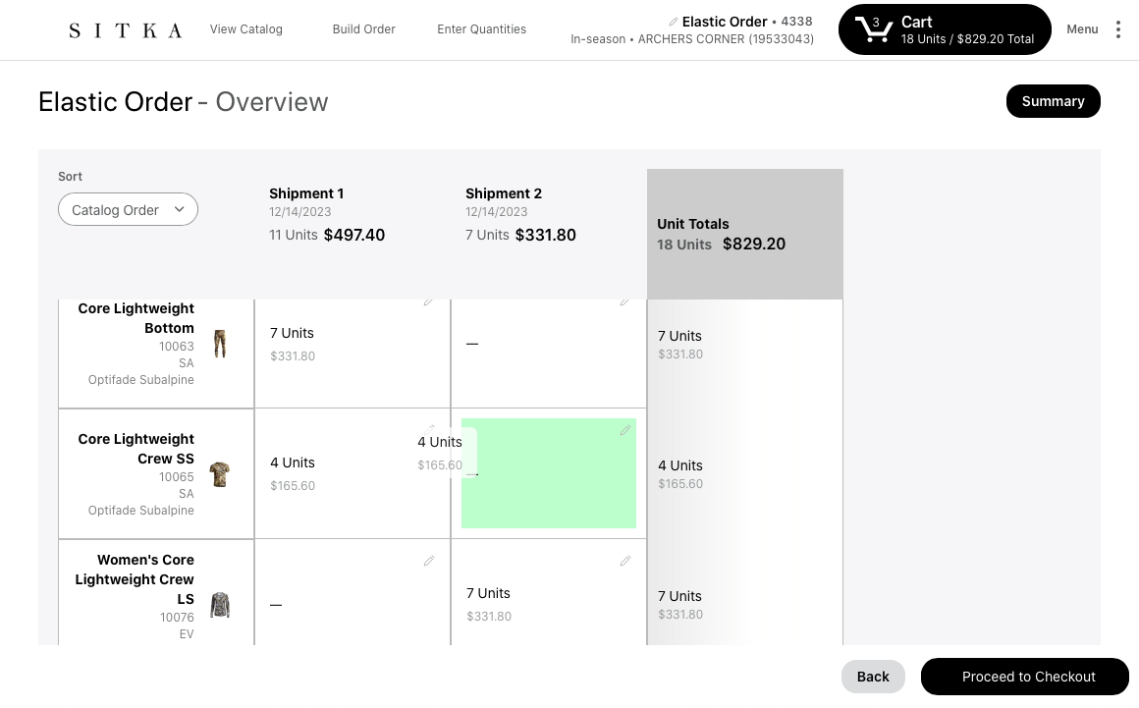
If you want to move items to a different shipment, simply drag and drop to the desired shipment

Slide 10
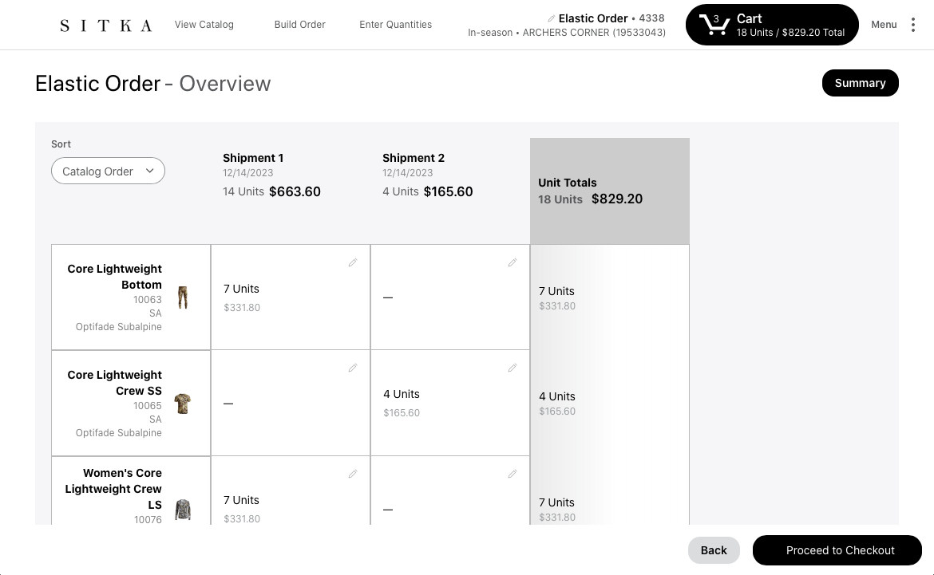
After reviewing your order, and double checking shipping dates and quantities, Proceed to Checkout

Slide 11
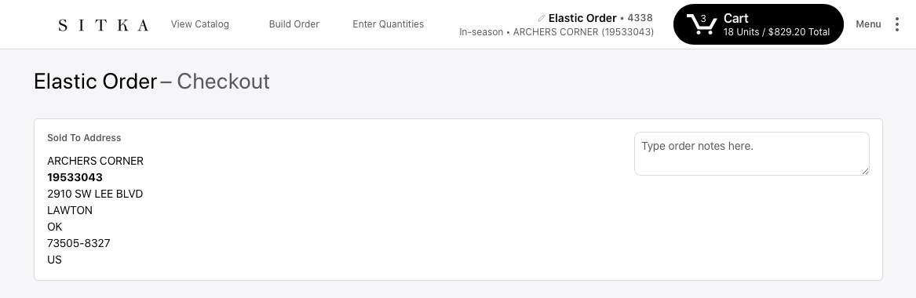
At the top of the page, your billing address will be listed. Double check that this is accurate!

Slide 12
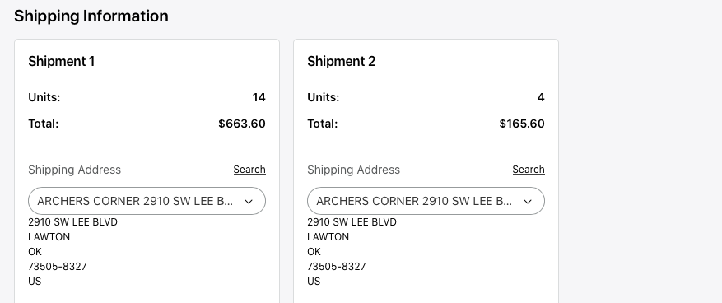
In the middle of the page, you will see your shipments and shipping address. Ensure the shipping address is correct, you may add a drop address if needed

Slide 13
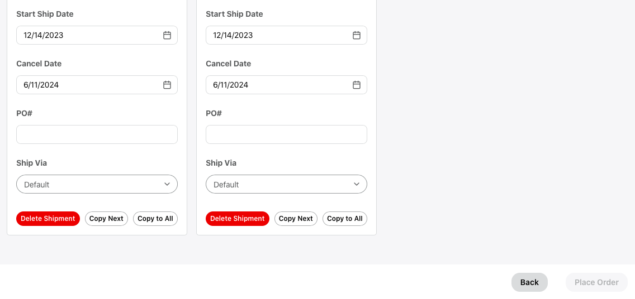
At the bottom of the page will be your start ship date and cancel date. Ensure all dates are correct.
Enter your desired PO for BOTH shipments.
Once both POs are filled out, the Place Order
button will turn black and you will be able to
select it

