Slide 1
Howler Envoy

Slide 2
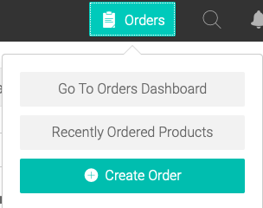
After logging in, select “Orders” at the top right of the page, followed by “Create Order”

Slide 3
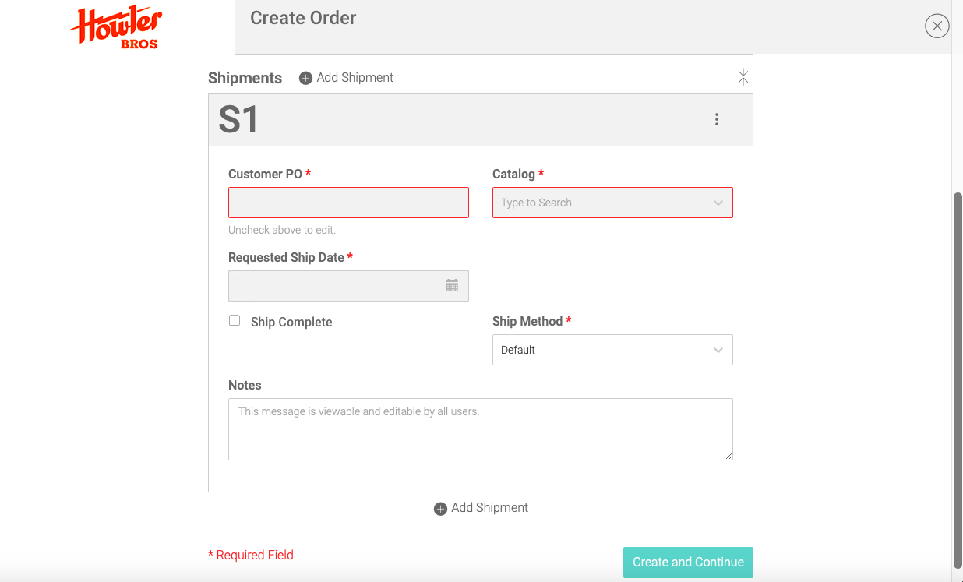
Here you will see all of the necessary information to add multiple shipments, select a catalog, add shipping dates, and insert a custom PO number if it is different than the order name.

Slide 4
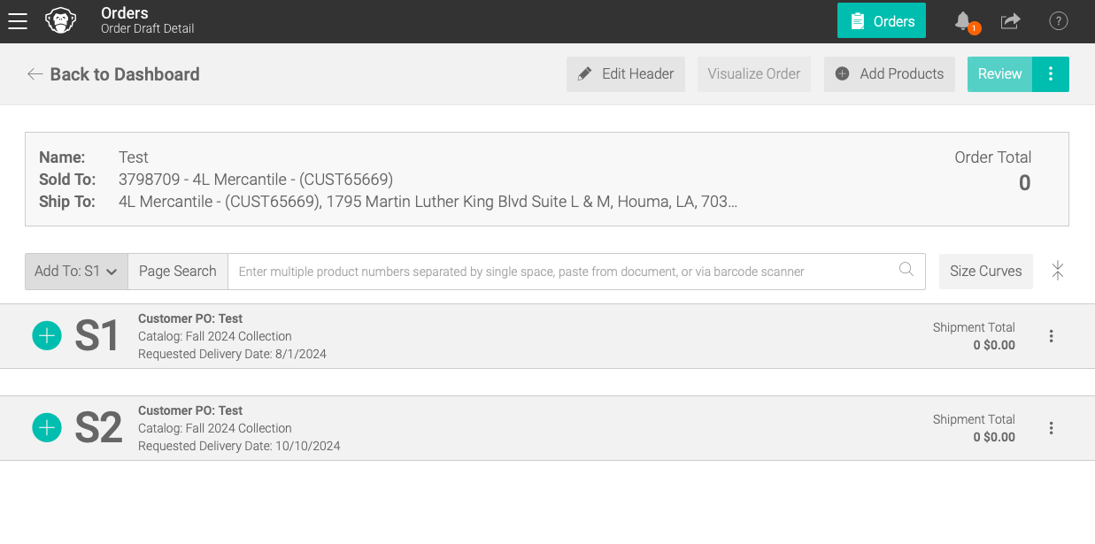
The following page will show how many shipments you created, which catalog you chose, and the requested delivery dates
To make any changes, select “Edit Header” at the top of the page
To begin placing items into your order, select the blue “+” symbol

Slide 5
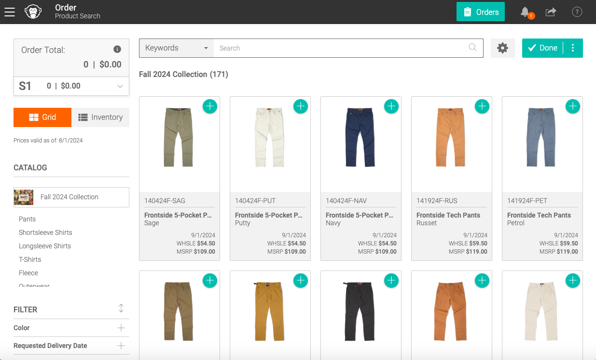
You can now either type Keywords or SKU #s in the search bar, or simply scroll through the products. To add an item to your shipment, click the blue “+” at the top right corner of every product
Once you have selected all of your desired products for Shipment 1, select “Done” in the top right corner

Slide 6
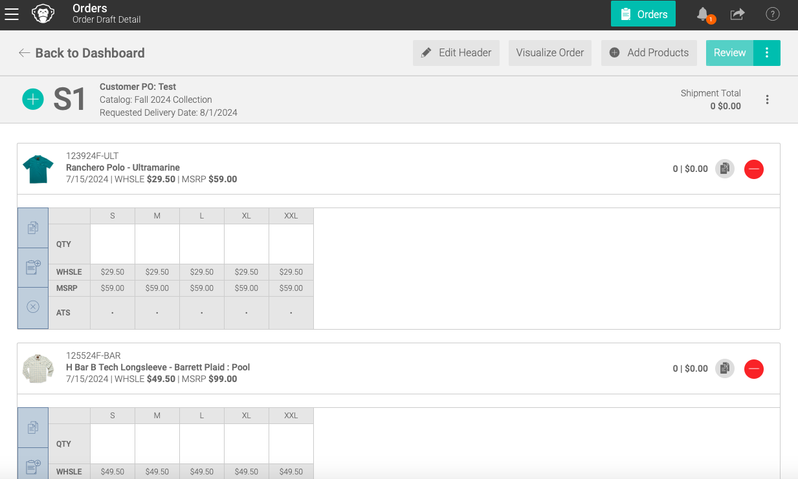
From here, you can add quantities and sizes for each product in Shipment 1

Slide 7
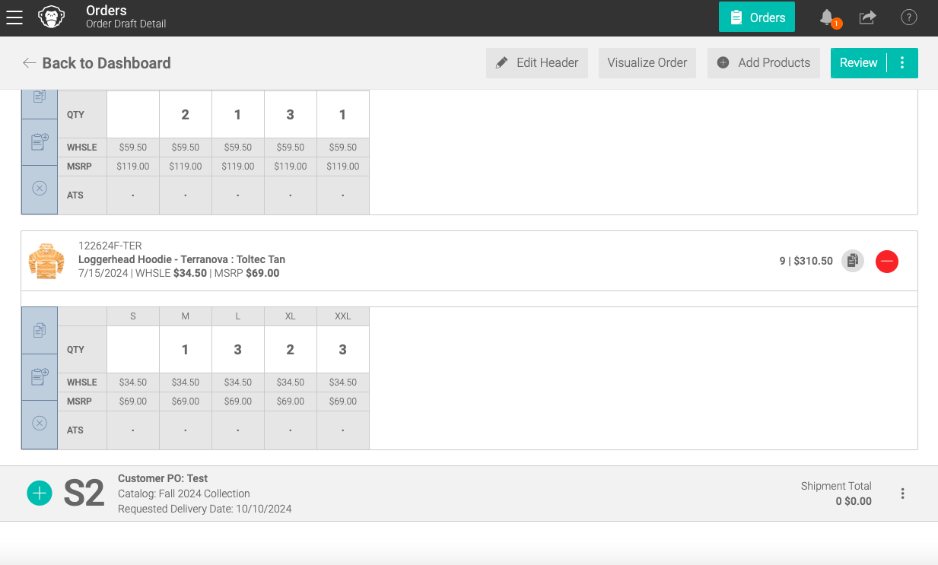
After scrolling through Shipment 1, you will see Shipment 2 at the bottom. Click the blue “+” next to S2 and follow the previous instructions from S1
If you only have 1 shipment, select “Review” at the top right corner of the page

Slide 8
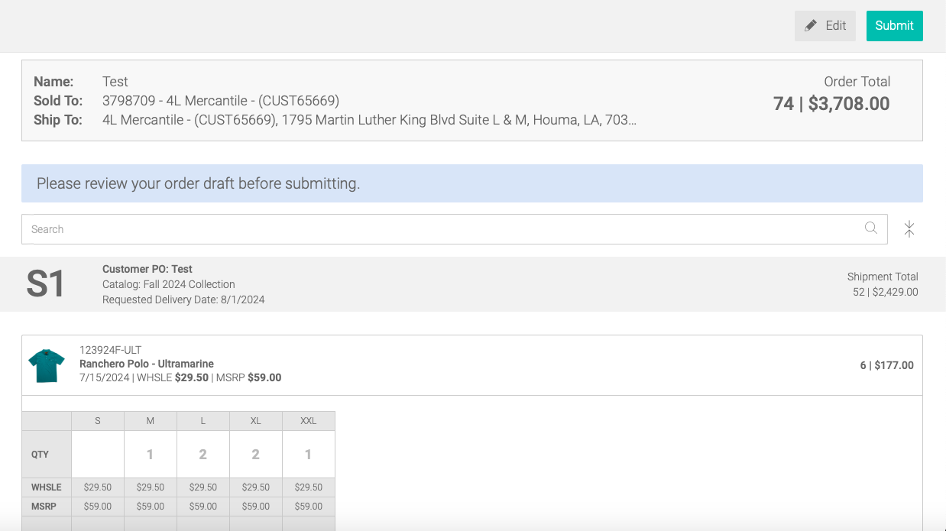
When reviewing your order, ensure all quantities/sizes, names/POs, and ship dates are correct
If you have multiple shipments, you can find how many products are in each shipment and the total cost of each shipment on the right side of the S1, S2, S3, etc. bars. The “Order Total” is all of the shipments (if there are multiple) combined
To make changes, select “Edit” in the top right corner of the page. If you are happy with your order, select “Submit”

